Slide 1
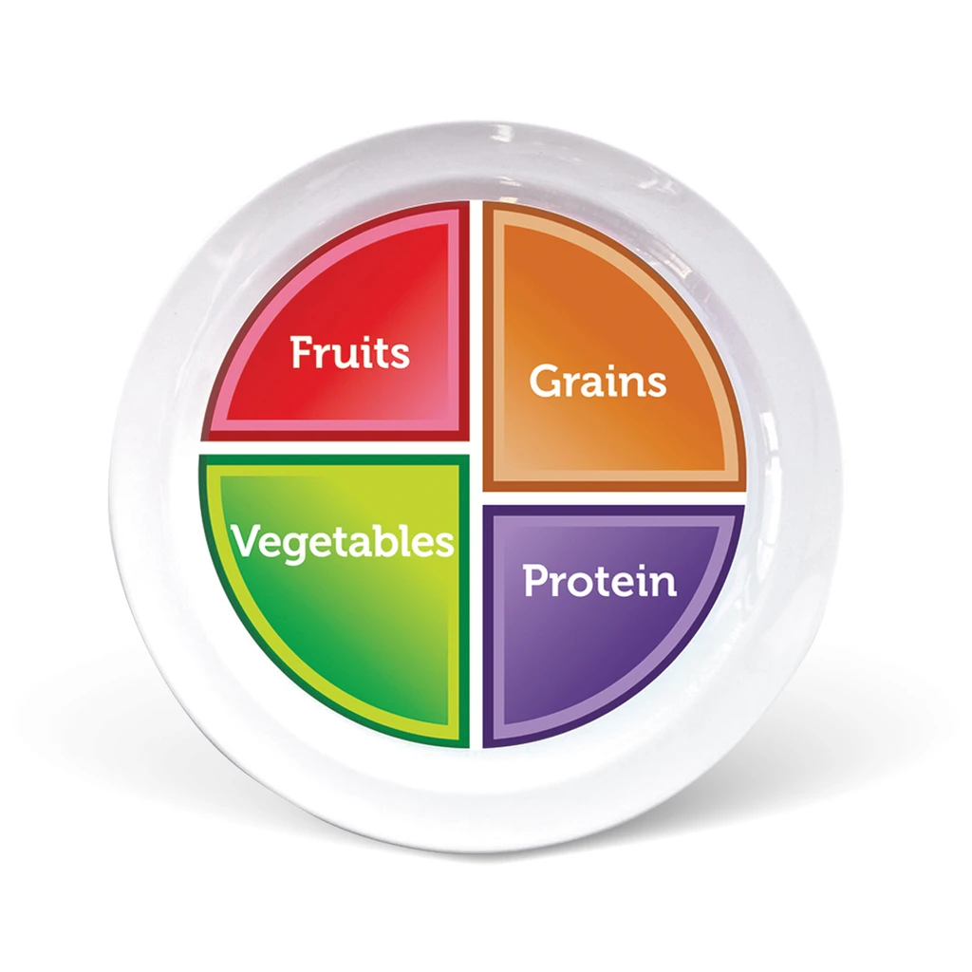
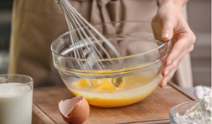
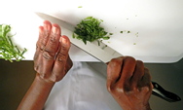
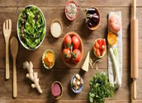
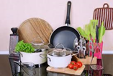
BTEC Home cooking skills
Key Stage 4 curriculum at Horizons Academy
Be able to pass on information about cooking meals at home from scratch
Understand how to cook economically at home
Home Cooking Skills Level 2
Be able to plan a nutritious, home-cooked meal using basic ingredients
Be able to prepare, cook and present a nutritious, home-cooked meal using basic ingredients
YEAR
11
SUMMER
Be able to review the menu and completed dishes
Plan and produce dishes in response to a brief
YEAR
Be able to plan a menu for a set brief
Be able to prepare and make the dishes on the menu
11
SPRING
Understand the value of passing on information about home cooking
Home Cooking Skills Level 1
Be able to use cooking skills to make home cooked food that does not use pre-prepared, ready-cooked food
YEAR
11
Be able to change recipes to make them healthier
AUTUMN
Exploring balanced diets
End of year exams
Level 1 functional skills paper.
YEAR
Understand the importance of a balanced diet
10
SUMMER
Be able to make informed choices when using food for cooking
Understand factors affecting food choices
Understanding food
Understand the sources of food
YEAR
10
Be able to use skills for food preparation and cooking
Understand recipes for cooking
SPRING
YEAR
Preparing to cook
10
AUTUMN
Understand how to prepare self and the environment for cooking
Understand how to prepare and store equipment and utensils

