Slide 1
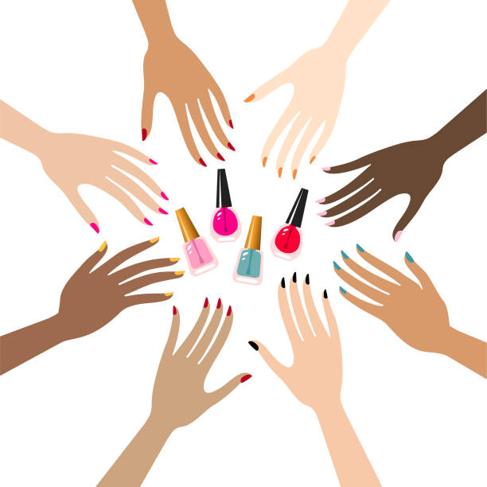
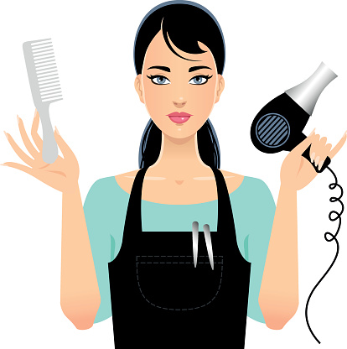
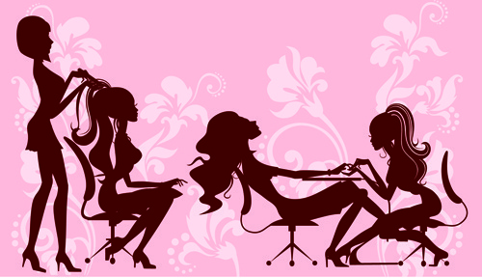
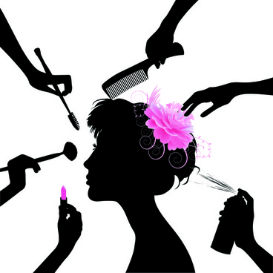
Key Stage 4
Year 10
Hair and Beauty
VTCT Level 1 Award in
Hair and Beauty Skills
- Nail art / Plaiting hair
End of unit SUMMATIVE assessment PRACTICAL
Continue onto Year 11
State the importance of carrying out a visual study of the hands and nails to identify factors that will influence the treatment
Communicate effectively and responsibly with others
End of unit FORMATIVE assessment - PRACTICAL
YEAR
Create and present a hair and beauty image using colour
10
Prepare yourself, your model and your work area
SPRING/SUMMER
YEAR
10
End of unit SUMMATIVE assessment WRITTEN
SPRING
Plan and create a mood board of ideas for your hair and beauty image using colour
Describe why it is important to create a mood board for your hair and beauty image
Describe the skills and techniques you can use to create your image using colour
Create a hair and beauty image using colour
YEAR
10
State the job roles for a hairdresser and a beauty therapist
State the job roles for a hairdresser and a beauty therapist
State the available opportunities within the hair and beauty sector
AUTUMN
YEAR
10
End of unit WRITTEN assessment
AUTUMN
Describe the main beauty treatments available
The hair and beauty sector
Describe the main hairdressing services available
Outline places of work in the hair and beauty sectors

