Slide 1
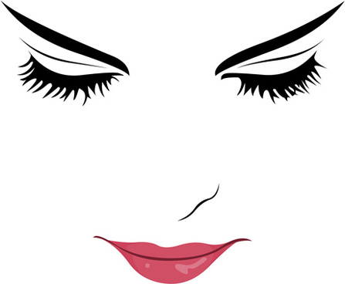
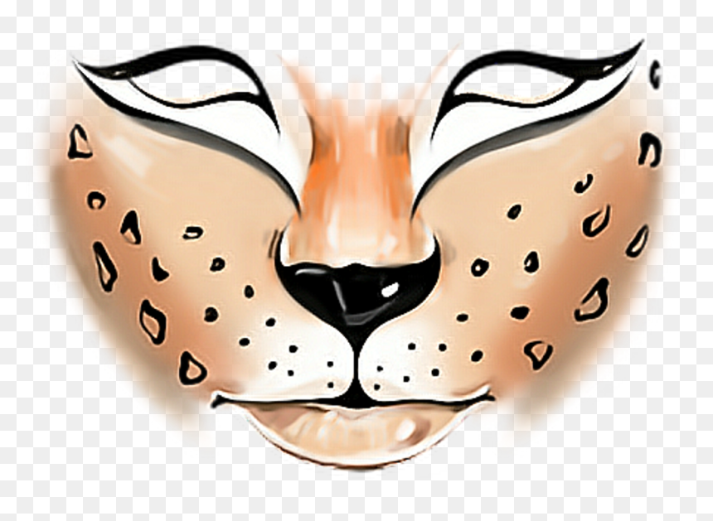
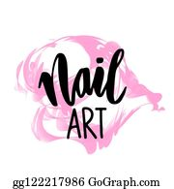
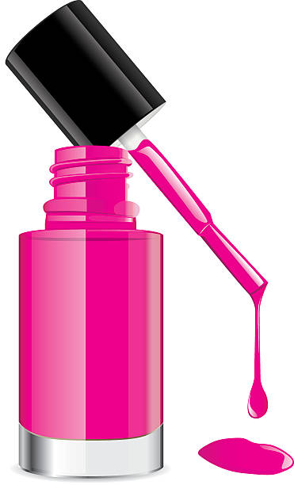
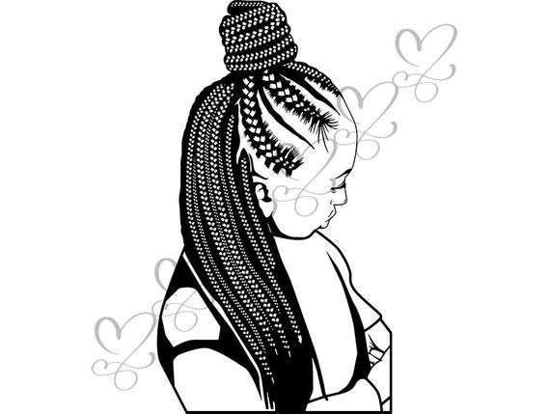
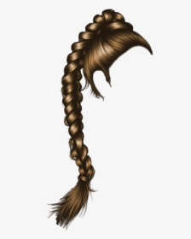
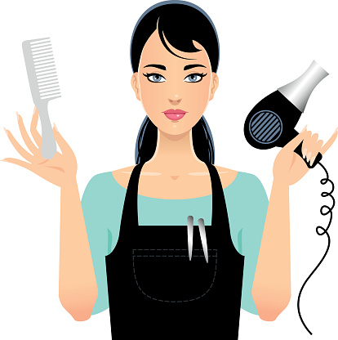
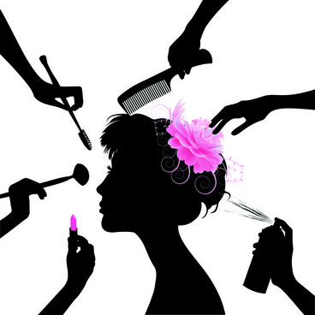
Key Stage 4
Year 11
Hair and Beauty
Go on to apprenticeship, college or A levels
Continue lifelong learning, university and or employment
End of unit SUMMATIVE assessment
End of unit SUMMATIVE assessment
Investigate the importance of preparation and removal of themed face painting
The factors that could influence the choice of themed face painting techniques
End of unit FORMATIVE assessment
Themed face painting
End of unit SUMMATIVE assessment
When and how to use products, tools and equipment
Research and create 2D themed face painting image
YEAR
11
SUMMER
Nail art application
Research and create 2D nail art images
Explore factors that could influence the choice of basic nail art techniques
Explore the products and basic techniques used in nail art
The factors that could influence the choice of basic nail art techniques
The importance of the preparation procedures for basic nail art techniques
End of unit FORMATIVE assessment
End of unit SUMMATIVE assessment
The different typical nail shapes and the basic nail structure
The salon’s requirement for preparing yourself, the client and work area
Providing basic manicure treatment
State the importance of carrying out a visual study of the hands and nails to identify factors that will influence the treatment
End of unit FORMATIVE assessment
The possible contra-actions and how to respond to them
End of unit SUMMATIVE assessment
When and how to use products, tools and equipment
Plaiting hair
The importance of the preparation procedure for plaiting and twisting techniques
End of unit FORMATIVE assessment
End of year exams
Level 1 functional skills paper.
YEAR
Identify a range of finished looks that use plaiting and twisting techniques
The factors that influence the choice of plaiting and twisting techniques
End of unit SUMMATIVE assessment
11
Spring
optional units
Create an image based on a theme
Describe the skills and techniques you can use to create your image using colour
Create a hair and beauty image using colour
End of unit SUMMATIVE assessment WRITTEN
Describe why it is important to create a mood board for your hair and beauty image
Plan and create a mood board of ideas for your hair and beauty image using colour
End of unit FORMATIVE assessment
YEAR
Present a professional image in a salon
11
AUTUMN
Identify the effects of positive and negative attitudes and behaviours
End of unit SUMMATIVE assessment
Identify how to promote a professional image in a salon
Identify how to maintain personal hygiene

